Slide 1
Cobblestone Gateway: The COI Process
A Guide to COI Process with Cobblestone Interface
School Affiliations Team

Slide 2
Create a new COI record for the affiliation agreement process
Upload supporting COI documents
Objectives

Slide 3
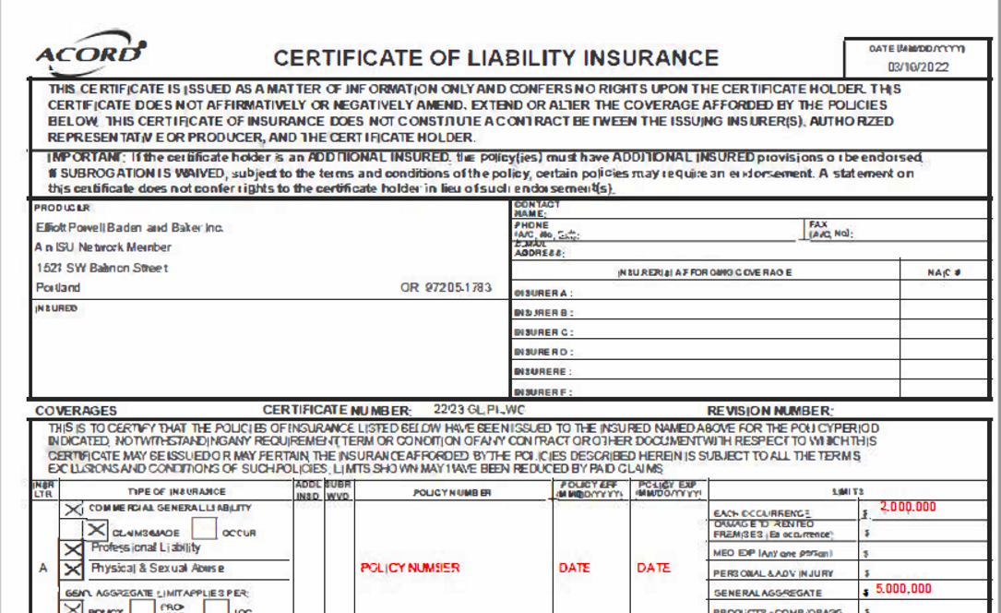
What is COI?
Certificate of Insurance (COI) is a document issued by the insurance company that verifies an insurance policy. It is a legal and risk requirement for the affiliation agreement process.
Providence will need a COI showing general liability insurance limits of at least $1,000,000 per occurrence and $3,000,000 aggregate.

Slide 4
Entering COI Information in Gateway

Slide 5
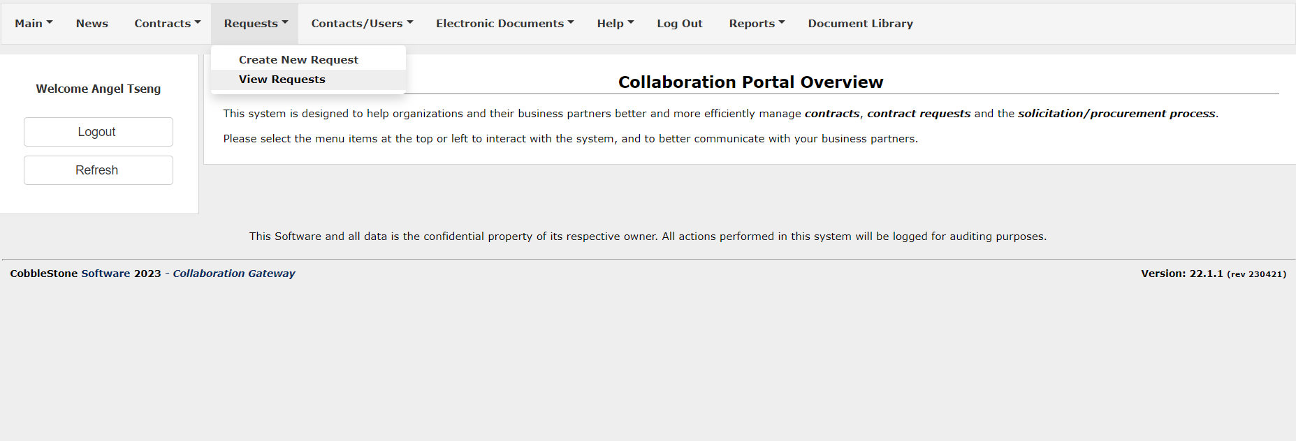
Creating a New COI Record
You will access the Gateway to create a new COI record
Log in to the Gateway with your created credentials
Click on “Requests” and then “View Requests” on the home page

Slide 6
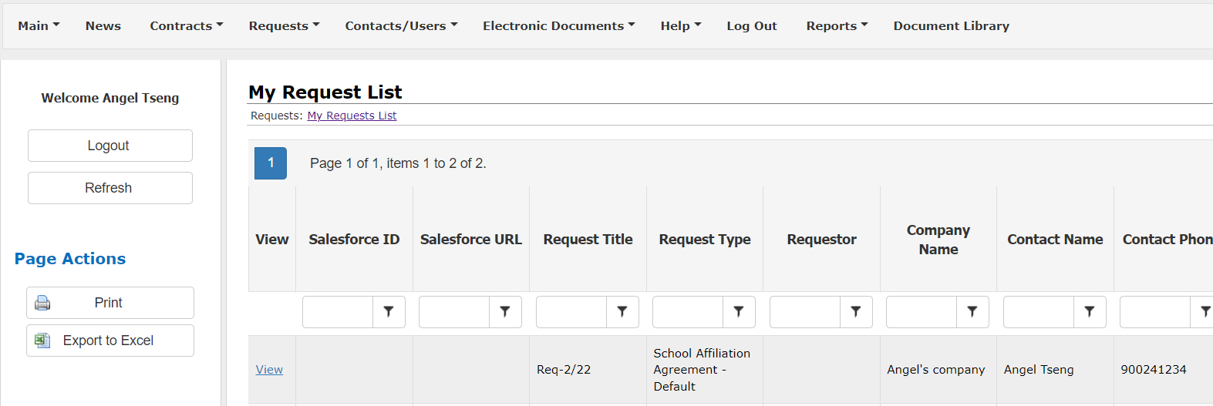
Creating a New COI Record
You will access the Gateway to create a new COI record
3. For the request you would like to create a COI record for, click on “View”

Slide 7
Creating a New COI Record
You will access the Gateway to create a new COI record
4. In Request Details, scroll down to the section “COI” and click “Add”

Slide 8
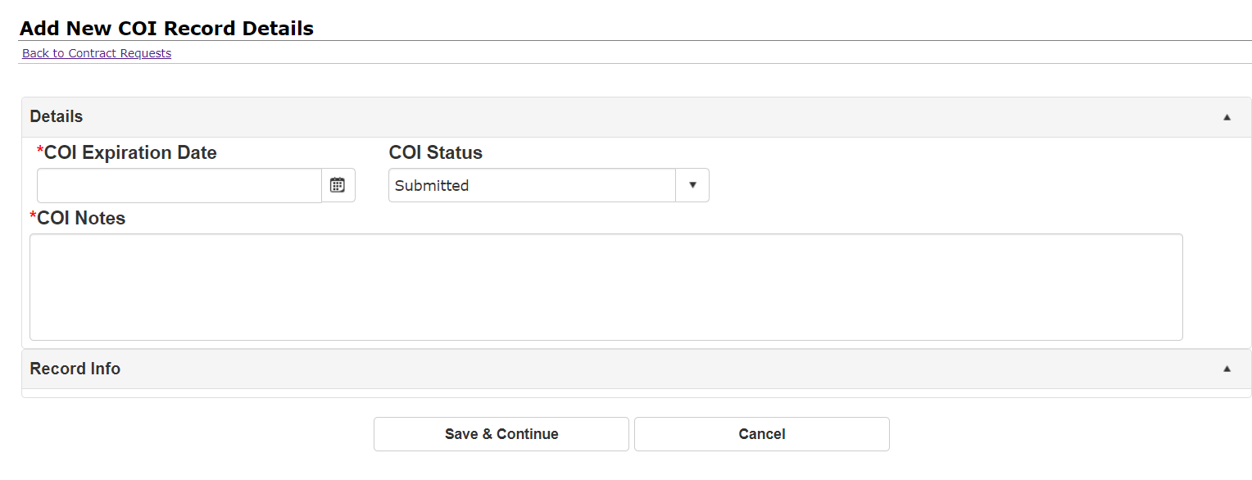
Creating a New COI Record
You will now enter your COI record information
Enter the COI expiration date and COI notes for your COI
Ensure the COI Status is “Submitted”
Click “Save & Continue” when finished

Slide 9
Uploading COI Documents in Gateway

Slide 10
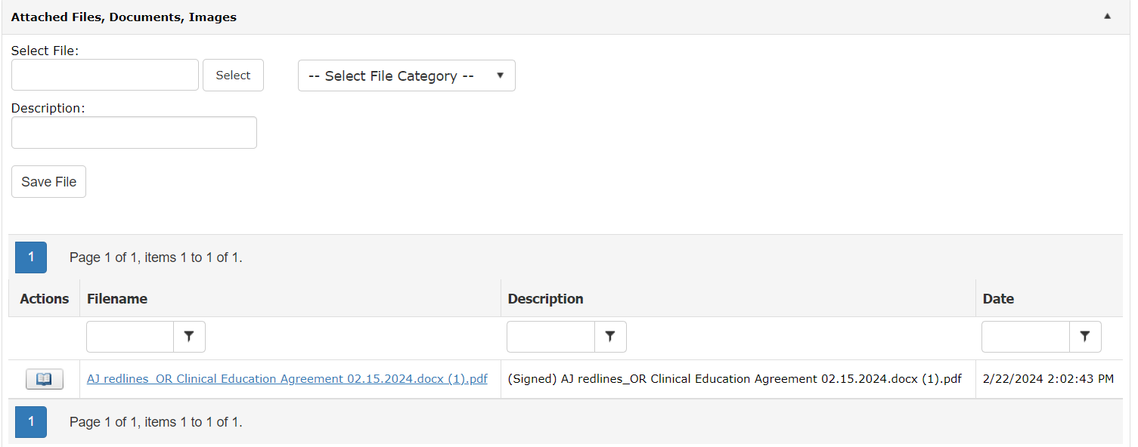
Uploading COI Documents
To complete the COI process, you will need to upload supporting documents
After creating a new COI record, you will be redirected back to the Request Details page
Scroll down to section “Attached Files, Documents, Images”

Slide 11
Uploading COI Documents
To complete the COI process, you will need to upload supporting documents
Using the Select File option to upload your COI documents
Add a description for the document, including the term "COI" and its expiration date
Click “Save file” to add the document
You can upload multiple COI documents if needed, be sure to add a description for each

Slide 12
Once you have created a COI record and uploaded the COI in the Gateway, the School Affiliations team will review your COI.
If your COI is rejected, you will receive an email alert. Follow these steps to provide an updated COI:
Log in to the Gateway and click on Request Details for the request
Create a new COI record in the Gateway
Upload the new COI document in the Gateway
Approvals & Rejections

Slide 13
Renewals

Slide 14
When your COI approaches its expiration date, the Gateway will send you an alert through email 60 days from the expiration date.
You will then be directed to log in to the Gateway and
Create a new COI record in your existing contract
Upload the new COI document in your existing contract
Renewals

Slide 15
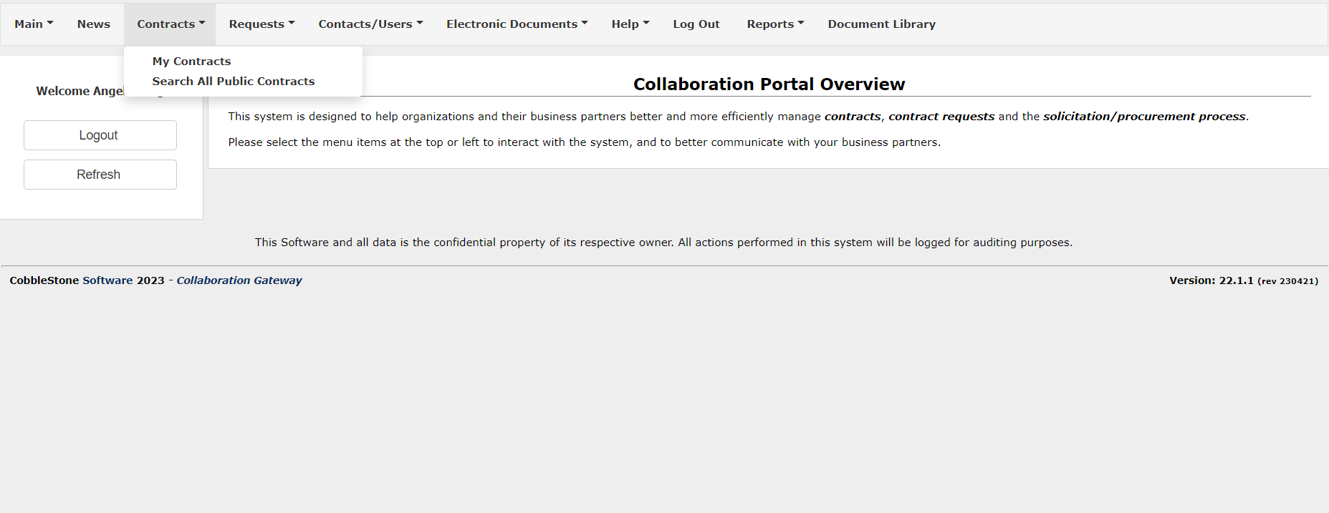
Creating a New COI Record
You will access the Gateway to create a new COI record in contracts
Log in to the Gateway with your created credentials
Click on “Contracts” and then “My Contracts” on the home page

Slide 16
Creating a New COI Record
You will access the Gateway to create a new COI record in contracts
3. For the contract you need to renew the COI record for, click on “View”

Slide 17
Creating a New COI Record
You will access the Gateway to create a new COI record in contracts
4. In Contract Details, scroll down to the section “Contract COI” and click “Add”

Slide 18
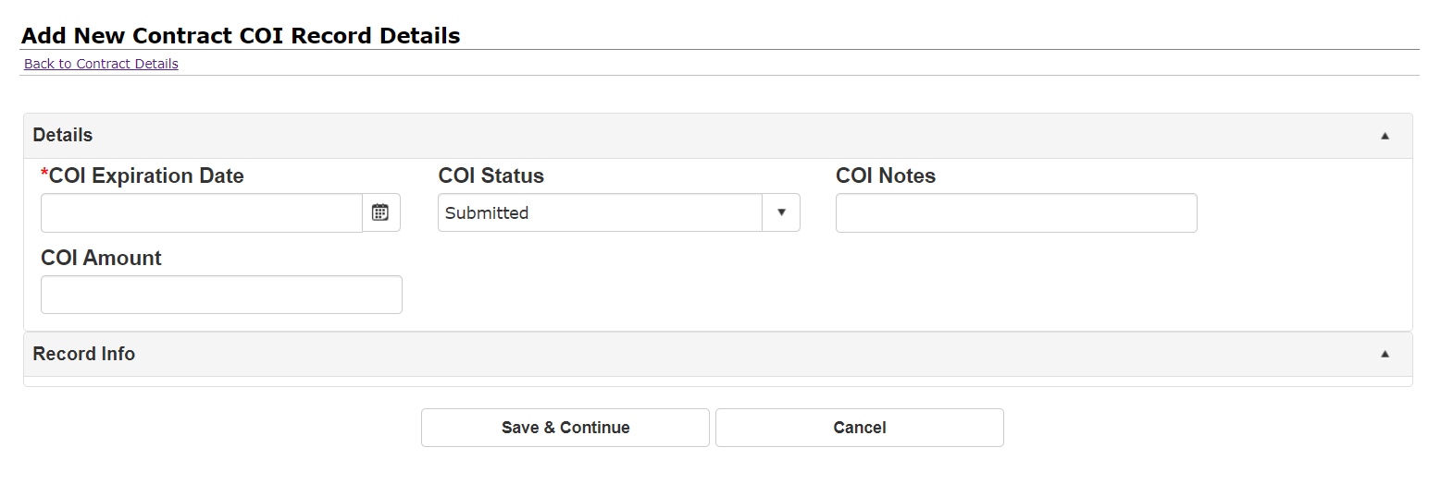
Creating a New COI Record
You will now enter your new COI record information
Enter information on your new COI
Ensure the COI Status is “Submitted”
Click “Save & Continue” when finished

Slide 19
Uploading COI Documents
Upload supporting documents for your new COI
After creating a new COI record, you will be redirected back to the Contract Details page
Scroll down to section “Attached Files, Documents, Images”

Slide 20
Uploading COI Documents
Upload supporting documents for your new COI
Using the Select File option to upload your new COI documents
Add a description for the document, including the term "COI" and its expiration date
Click “Save file” to add the document
You can upload multiple COI documents if needed, be sure to add a description for each

Slide 21
Questions? Contact us at ORRegHRSchoolAffiliation@providence.org Thank you and we look forward to working with you during the process!

