Slide 1
Cobblestone Gateway Overview
An Introduction to the Cobblestone Gateway Interface
ProvReady School Affiliations Team

Slide 2
To become familiar with the affiliation agreement process with Cobblestone
Get started in Cobblestone Gateway
Objectives

Slide 3
Cobblestone & Affiliation Agreement Process

Slide 4
What is Cobblestone?
A contract management system that will be used for the affiliation agreement process with Providence.
Cobblestone Gateway: The Gateway interface within CobbleStone is the main interface you will be working with. Please bookmark the appropriate login screen when setting up your account.
In the Gateway, you will be able to:
Initiate a request to start the agreement process
Access required documents
Communicate with School Affiliations team on redlines
Make edits and upload documents as necessary
Sign the affiliation agreement!
Download the fully executed affiliation agreement

Slide 5
The Affiliation Agreement Process with Cobblestone
School Affiliations Team Review
Schools Access Agreement in Gateway
Schools Review Redlines / Make Edits
Providence Teams Review Redlines / Make Edits
Schools Make a Request in Gateway
E-sign Agreements in Gateway

Slide 6
Navigating Cobblestone Gateway

Slide 7
Registering an Account

Slide 8
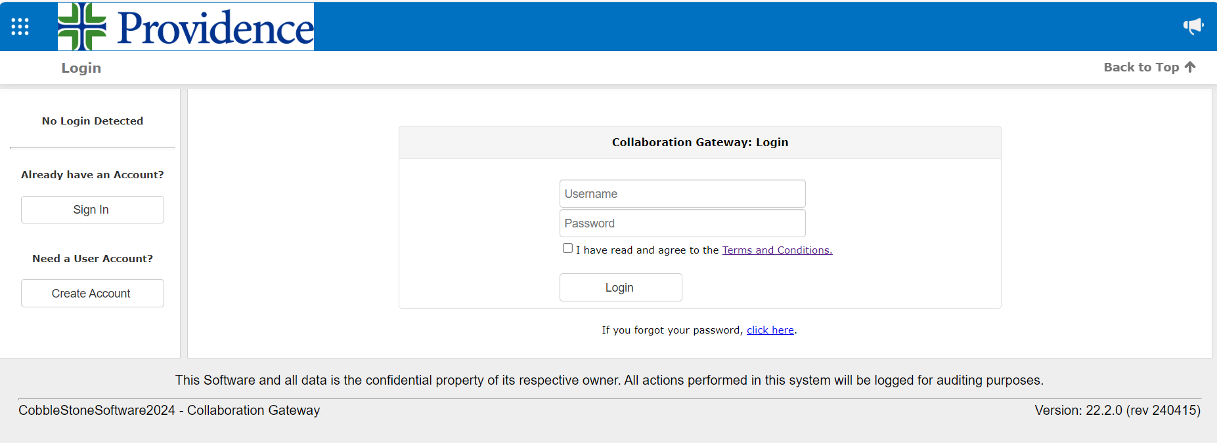
Signing Up
Anyone from the school who needs access to your documents/process may create an account
Creating an account in Gateway
Use this link to access Gateway for Providence
Click on “Create Account” on the left of the screen

Slide 9
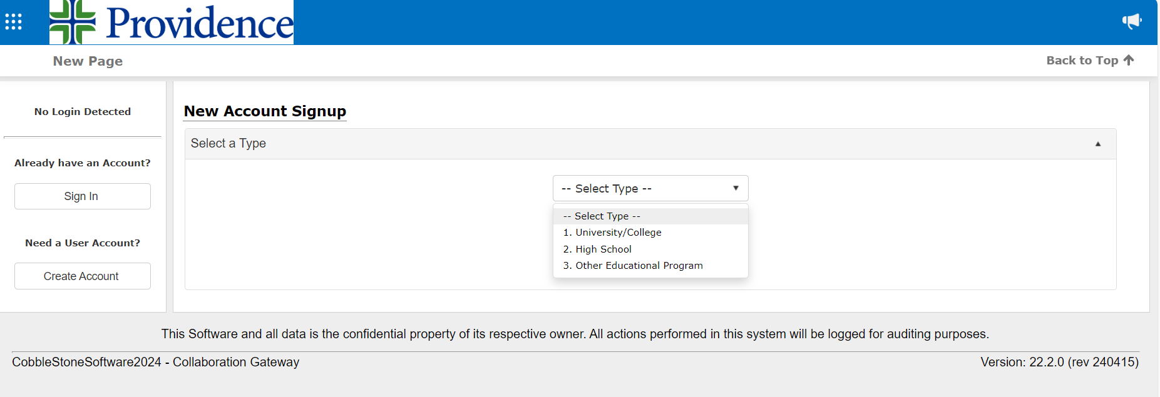
Signing Up
Creating an account in Gateway
3. For Account Type, choose the appropriate school type for your school and click Continue

Slide 10
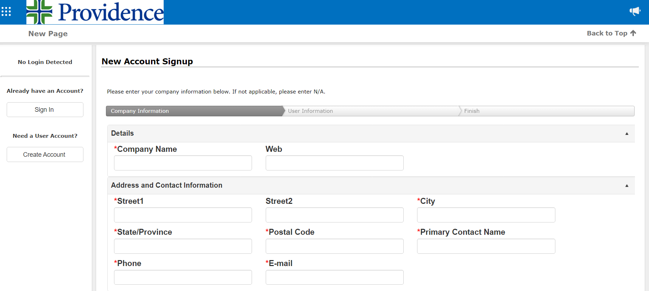
Signing Up
Creating an account in Gateway
Fill in relevant company and user information to complete the registration
You will receive a confirmation email after creating your account
You should now be signed up in the Gateway to start the affiliation agreement process!

Slide 11
Making a Request

Slide 12
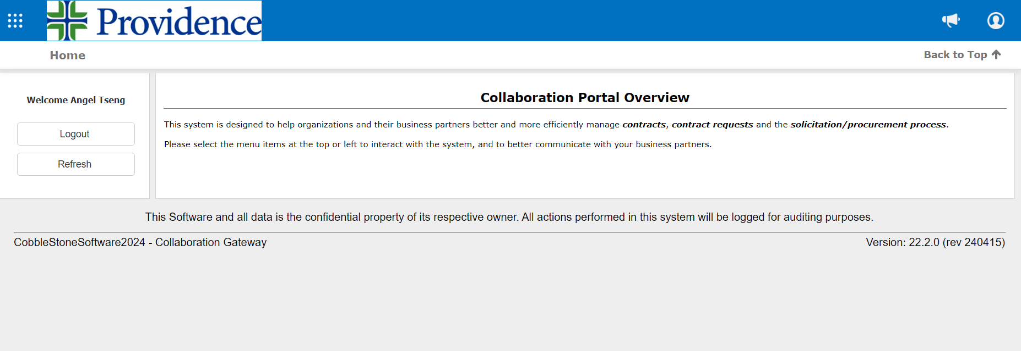
Making a Request
You will first make a request to start the affiliation agreement process
Once the account is created, please wait about 5 minutes for account activation
After 5 minutes, sign in and click on the waffle icon (9 white dots) on the top left corner of the page

Slide 13
Making a Request
You will first make a request to start the affiliation agreement process
Click on Submit New Request in the options provided

Slide 14
Making a Request
Make a request to start the affiliation agreement process
4. In “Select a Record Type”, select School Affiliation Agreement - Default

Slide 15
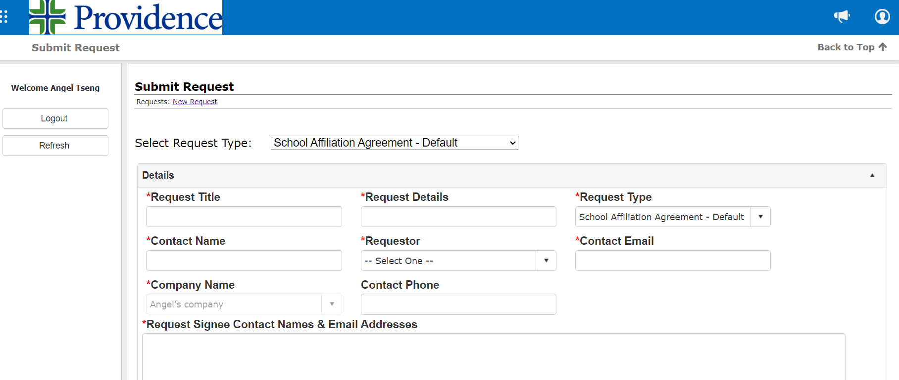
Making a Request
Make a request to start the affiliation agreement process
5. Fill in information about your request
In “Request Signee Contact Names & Email Addresses”, fill in the first name, last name, and email of the people who will be signing the affiliation agreement on your side

Slide 16
Making a Request
Continue filling out request to start the affiliation agreement process
6. Make sure to answer the question about whether the agreement will cover all students at your school
If you answer yes, answer the sequential question with “N/A”
If you answer no, answer the sequential question on who the agreement will cover

Slide 17
Making a Request
Complete the request to start the affiliation agreement process
Fill in the effective date in “Effective Date”
Fill in the expiration date of the agreement in “Expiration Date”
You can set the expiration date to be up to five years from the effective date
After submitting the request, you should receive a confirmation email about your request being made

Slide 18
Redline Process

Slide 19
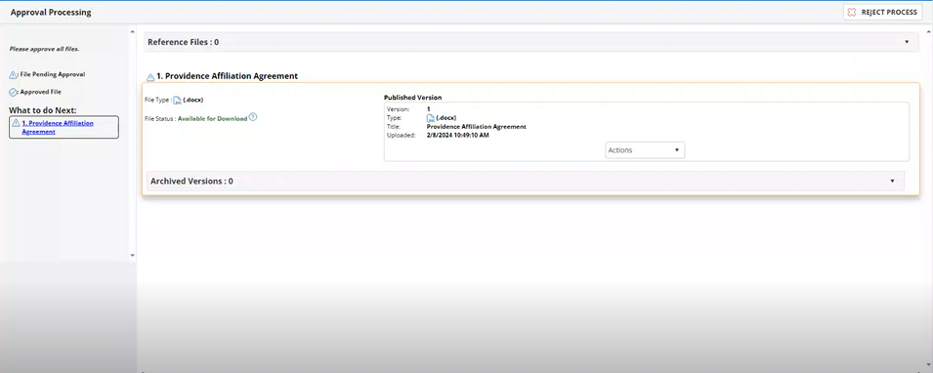
Viewing & Accessing Agreement
School Affiliations Team will review your request, and provide you access to the agreement
When notified in email about viewing your agreement, follow the link to the Gateway
Use the drop-down menu in “Actions” access the document
Note: To view any redlines made in the process, you will need to download the document

Slide 20
Using the Drop-Down Menu
You can perform different actions to the affiliation agreement with options below:
Comment: To make comments about the document
Upload: To upload a modified version of a document
Download: To download the document to view any changes made or to edit
Preview: View the document in the online document system of Gateway
Note: Preview will not display any changes made
Edit: To make quick edits in the online document editor system of Gateway
Approve: To approve the current version of affiliation agreement

Slide 21
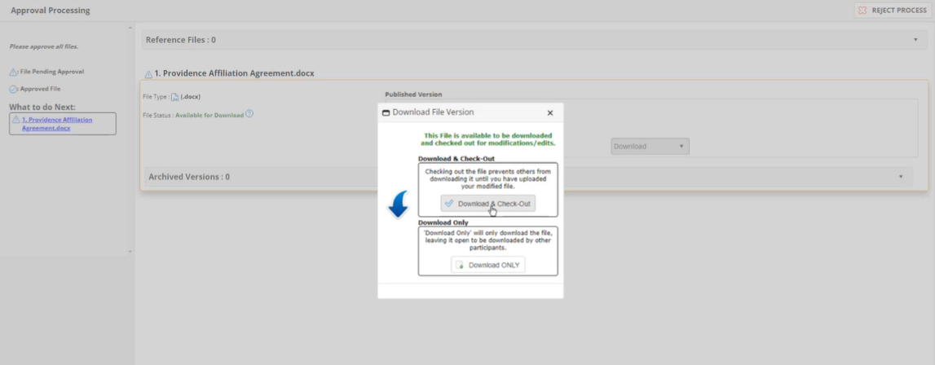
Viewing & Accessing Agreement
If you choose to edit, download the document to make changes:
Click “Download” in the drop-down menu to download the document locally
Click “Download & Checkout” to prevent others from downloading before your edits have been made

Slide 22
Viewing & Accessing Agreement
To download the document to make changes:
3. Enable editing, then click “Review” and “Track Changes” to ensure any changes you make are tracked
Make necessary changes on your local device and save them when finished
Always make sure your changes are being tracked!

Slide 23
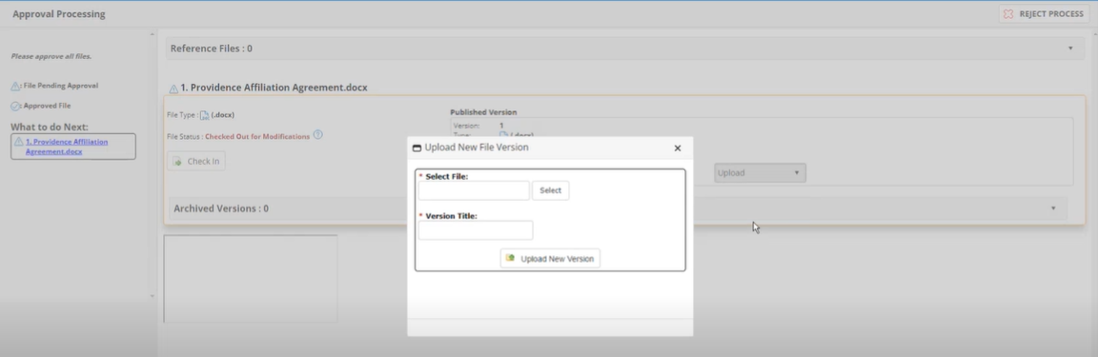
Viewing & Accessing Agreement
After making changes on your local device, you will need to upload the file as a new version
Go back to the Gateway using the link from the email you received on document collaboration
Use the drop-down menu to click on “Upload”
Upload the document and provide a Version Title that includes the date

Slide 24
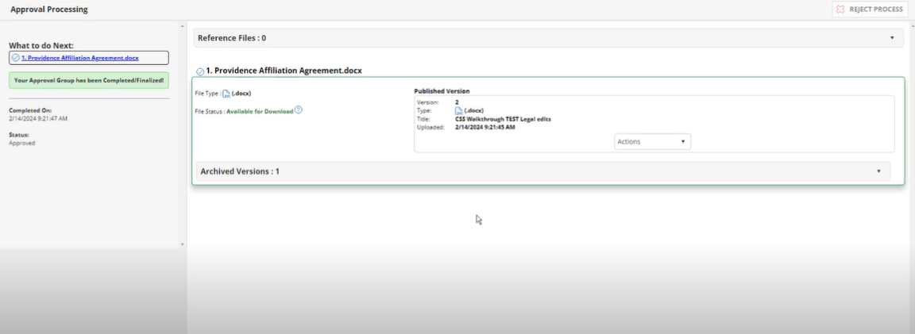
Viewing & Accessing Agreement
Providence teams will now review your edits for redlines
8. After uploading, you should see the message “Your Approval Group has been Completed/Finalized”
This process will continue until all redlines are addressed, see next slide

Slide 25
Redline Process in the Gateway
Schools Receive an email to Address Redlines
Schools Access Gateway to Download the Agreement
Schools View/Edit Redlines Locally as Needed
Schools Upload the New Version into Gateway
Providence Teams Review Redlines / Make Edits

Slide 26
Making Notes and Comments

Slide 27
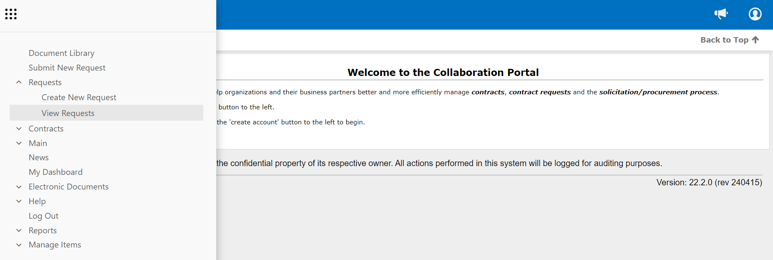
Comments and Notes in the Gateway
If needed, you can communicate with the School Affiliations Team through comments and notes
Log into the Gateway and click on the waffle icon (9 white dots) on the top left corner of the page
Click on Requests, then click on View Requests

Slide 28
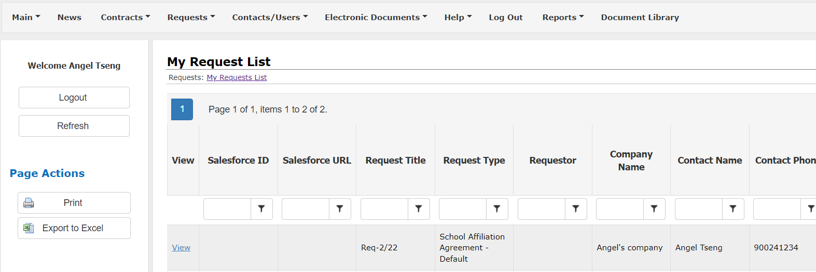
Comments and Notes in the Gateway
If needed, you can communicate with the School Affiliations Team through comments and notes
3. Click on “View” for your request

Slide 29
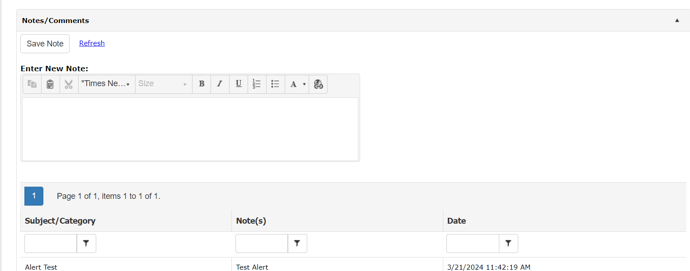
Comments and Notes in the Gateway
If needed, you can communicate with the School Affiliations Team through comments and notes
Scroll down to the Notes/Comments section and enter a note or comment
Click Save Note when finished

Slide 30
Approving & Signing Agreement

Slide 31
Approving Agreement
When you get to the stage where you downloaded the agreement to view redlines but you don’t think any further changes are needed, you can then approve the agreement
You do not need to reupload the document in this step. Go back to the Gateway using the link from the latest document collaboration email.

Slide 32
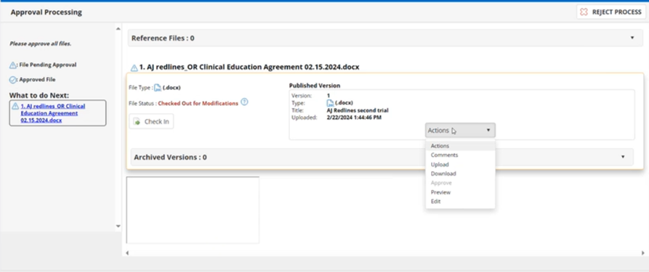
Approving Agreement
You will now approve the affiliation agreement
Click on “Check In” to check the document back in without changes
Use the drop-down menu to click “Approve”
This action confirms your approval to the current version of the agreement with all the changes included in the agreement
Providence teams will now view and approve the agreement

Slide 33
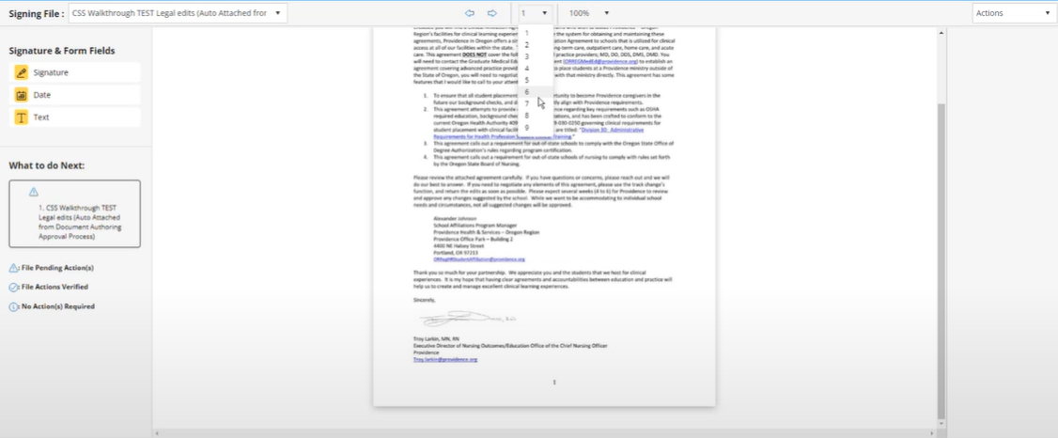
E-signing Affiliation Agreement
After all redlines have been reviewed and accepted by all parties, you will sign the affiliation agreement in Gateway
You should receive an invitation email on the signing process, click on the link “Sign Your Document” to access the webpage in Gateway
Please read the Electronic Record and Signature Disclosure, check the box if you agree and click continue
Review the affiliation agreement. Use the drop-down menu at the top to move to the next page

Slide 34
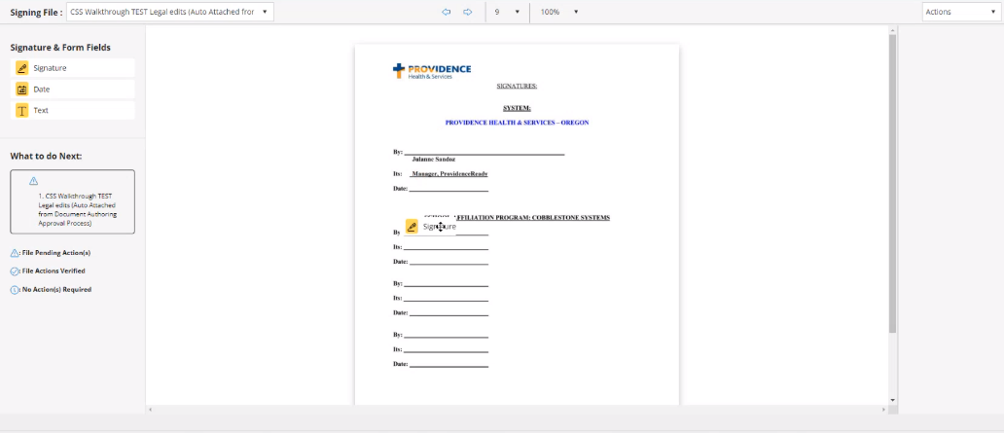
E-signing Affiliation Agreement
Inserting signature
When you finish reviewing the agreement, go to the signature page of the agreement
Click on the signature box on the appropriate signature line

Slide 35
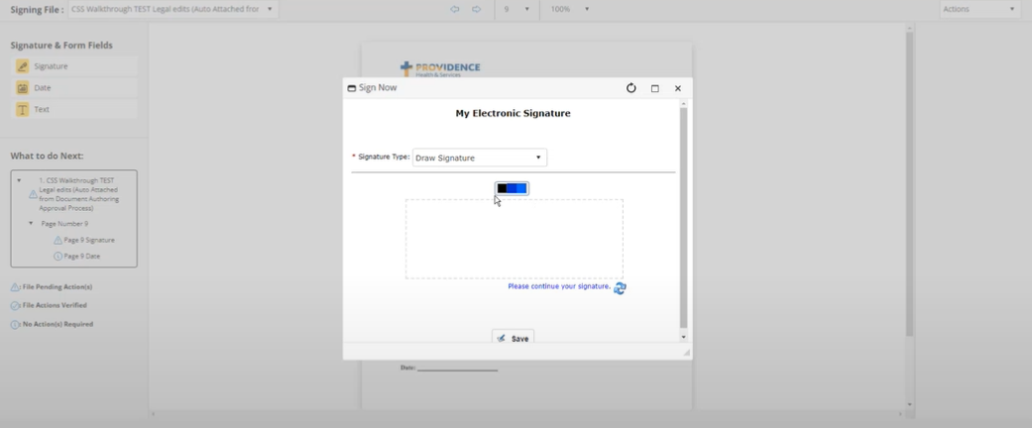
E-signing Affiliation Agreement
Inserting signature
Using your preferred method, sign the agreement
Click “Save” when finished

Slide 36
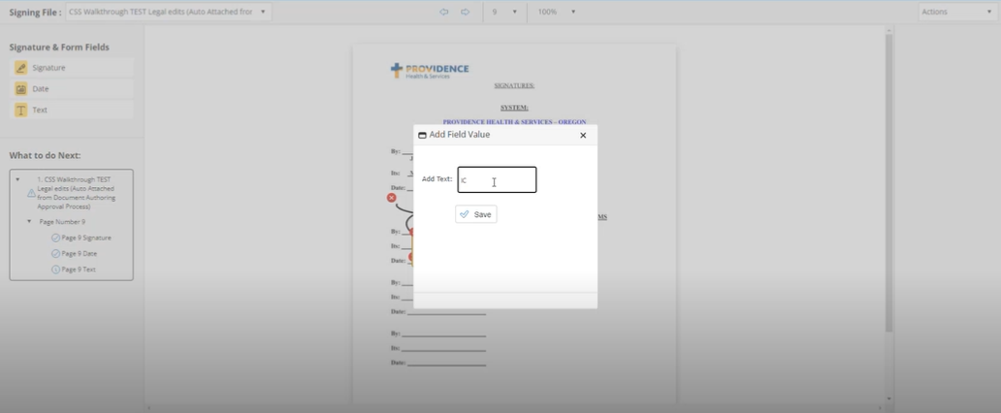
E-signing Affiliation Agreement
Inserting Initials
Click on the text box for your initials
Type in your initials
Click “Save” when finished

Slide 37
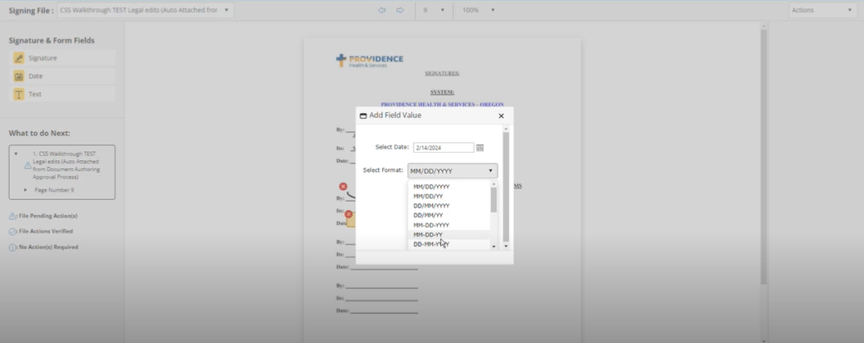
E-signing Affiliation Agreement
Inserting Date
Click on the date box on the appropriate date line
Select the appropriate date and its format
Click “Save” when finished

Slide 38
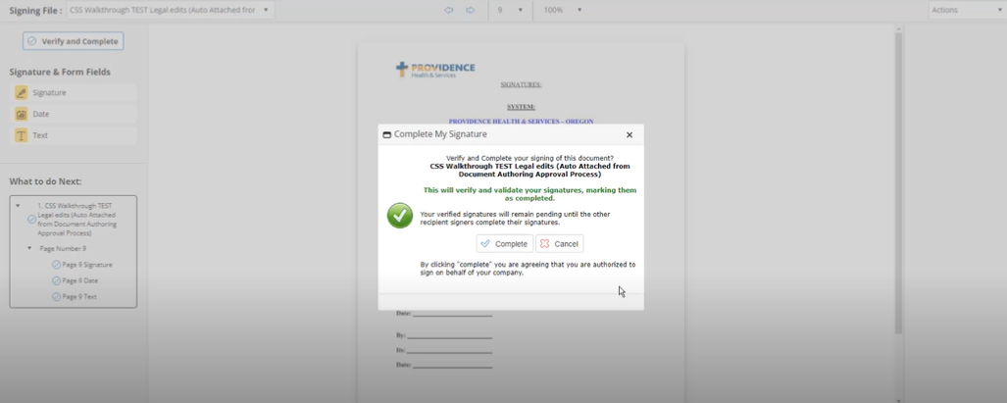
E-signing Affiliation Agreement
Verifying Signatures
Click “Verifying and Complete”
Click “Complete”
You will see the message “Signature Process Finalized Successfully”

Slide 39
COI Process

Slide 40
Creating a New COI Record
You will now input your COI information
Click on the waffle icon (9 white dots) on the top left corner of the home page
Click on Requests, then click on View Requests

Slide 41
Creating a New COI Record
You will now input your COI information
2. Click on “View” for the request you just made

Slide 42
Creating a New COI Record
You will now input your COI information
3. In Request Details, scroll down to the section “COI” and click “Add”

Slide 43
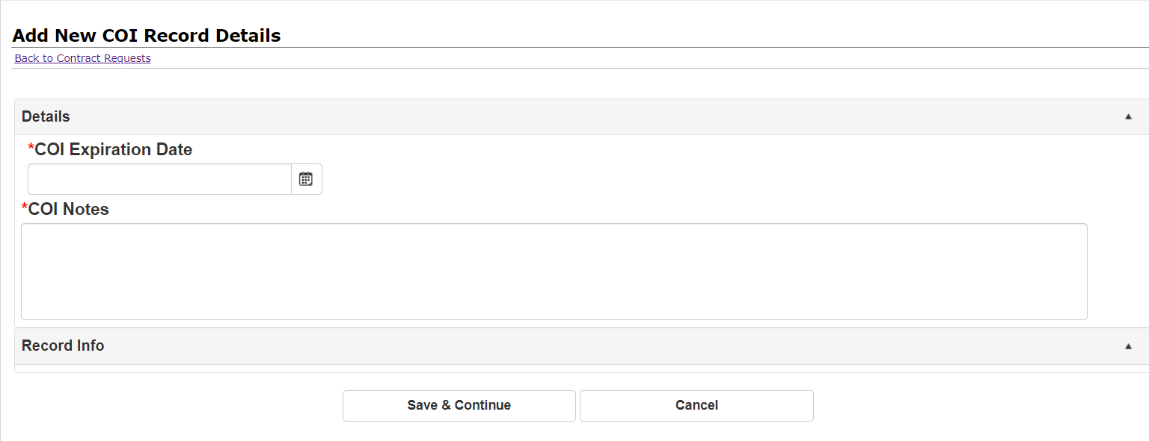
Creating a New COI Record
You will now enter your COI record information
Enter your COI expiration date and any notes of your COI
Click “Save & Continue” when finished

Slide 44
Uploading COI Documents
To complete the COI process, you will need to upload supporting documents
After creating a new COI record, you will be redirected back to the Request Details page
Scroll down to section “Attached Files, Documents, Images”

Slide 45
Uploading COI Documents
To complete the COI process, you will need to upload supporting documents
Using the Single File Upload option to upload your COI documents
Add a description for the document, including the term "COI" and its expiration date
Click “Save file” to add the document
You can upload multiple COI documents if needed, be sure to add a description for each

Slide 46
Once you have created a COI record and uploaded the COI in the Gateway, the School Affiliations team will review your COI.
If your COI is rejected, you will be expected to follow the same steps to provide an updated COI:
Create a new COI record in the Gateway
Upload the new COI document in the Gateway
Approvals & Rejections

Slide 47
Questions? Contact us at ORRegHRSchoolAffiliation@providence.org (Please do not reach out to CobbleStone directly, as they will be unable to assist) Thank you and we look forward to work with you during the process!

